Slide 1

12 App Compatibility Feature on Demand
Windows Server 2019 Basics

Slide 2
Features on Demand
They are extra features or capabilities not included by default in the Windows image
Can be added using the DISM tool or the DISM Powershell module
FODs are .cab files that can be obtained from Windows Update, WSUS or a FOD repository like the FOD ISO image

Slide 3
Features on Demand types
Without satellite packages: The FOD is packaged with the needed language resources in one .cab file
Can be installed with DISM via the /Add-Capability or /Add-Package commands
With satellite packages: The FOD is formed from multiple .cab files which could contain language resources for example
Can be installed with DISM only with /Add-Capability and from a special FOD repository

Slide 4
App Compatibility FOD
Can be installed only on Server Core (do not try to add this capability to Windows Server with Desktop Experience)
Increases compatibility of apps with the Server Core installation variant
Adds multiple troubleshooting options for system admins by providing a lot of MMC tools and more
Notes:
Tools included in the App Compatibility FOD:
- Microsoft Management Console (mmc.exe)
- Event Viewer (Eventvwr.msc)
- Performance Monitor (PerfMon.exe)
- Resource Monitor (Resmon.exe)
- Device Manager (Devmgmt.msc)
- File Explorer (Explorer.exe)
- Windows PowerShell (Powershell_ISE.exe)
- Disk Management (Diskmgmt.msc)
- Failover Cluster Manager (CluAdmin.msc) – Failover Clustering feature needs to be added in order to use it
- Internet Explorer – install separately after App Compatibility is installed

Slide 5
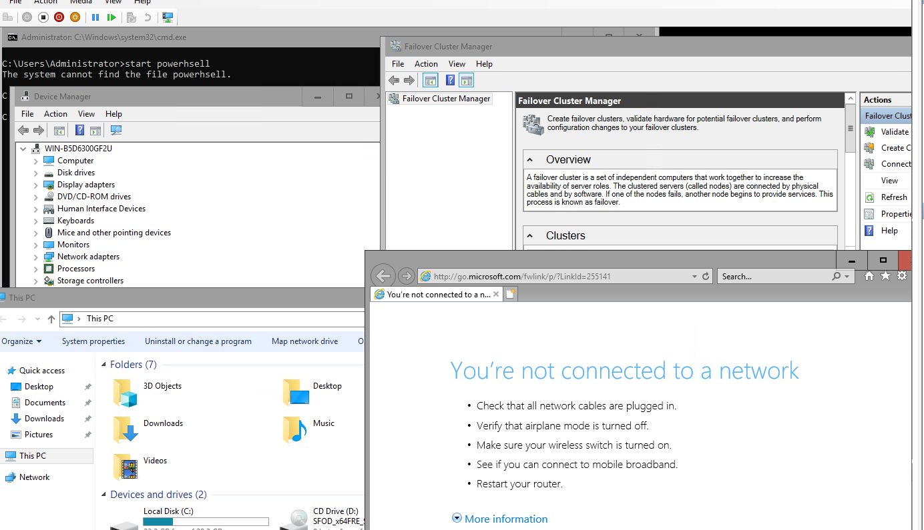
App Compatibility FOD in action

Slide 6
https://www.youtube.com/channel/UCcZ-jLbPwNr8E_v9-65n8Iw https://github.com/itknowledge4

